Slide 1



On-demand Data Fusion with Belvedere™
AI FOR DATA CURATION | DATA ENGINEERING | DATA OBSERVABILITY
CLEARFRACTURE.AI
01/13
Notes:
1

Slide 2
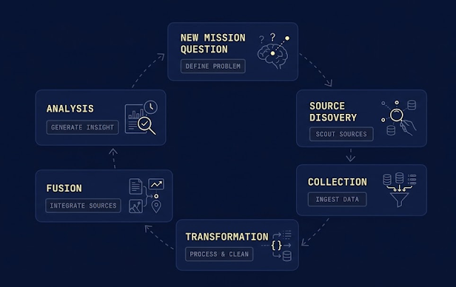
THE AGE-OLD PROBLEM
Missions are Left Waiting
Data preparation continues to be 80% of the problem and current solutions cause other issues…
01
Data needs are uncertain until a question is asked
Attempting to preprocess everything is too expensive and often wasted on preparing data that is never used
02
Sources change without warning
Detecting and recovering from surprise failures increases ongoing maintenance costs and decreases mission reliability
03
One-size doesn’t fit all
Individual cognition requires training and reframing; data attributes vary making conflation situational
04
Tools and data are complex and varied
Education requirements increase lock-in and expense; often teams are needed to understand systems end-to-end; policies aren’t enforced because they aren’t widely known
05
Knowledge is implicit
Months of the work isn’t answering questions, it’s just getting ready!
Forgetfulness and turnover result in loss; expert-finding is a constant struggle
CLEARFRACTURE.AI
Notes:
17

Slide 3

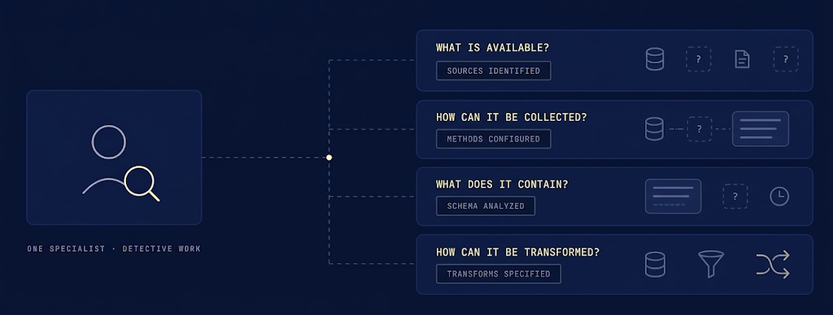
THE AGE-OLD PROBLEM
The Work Before the Work
Data is dumb and doesn’t help you use it. A person must investigate by hand, every time.
CLEARFRACTURE.AI
03/13
Notes:
3

Slide 4
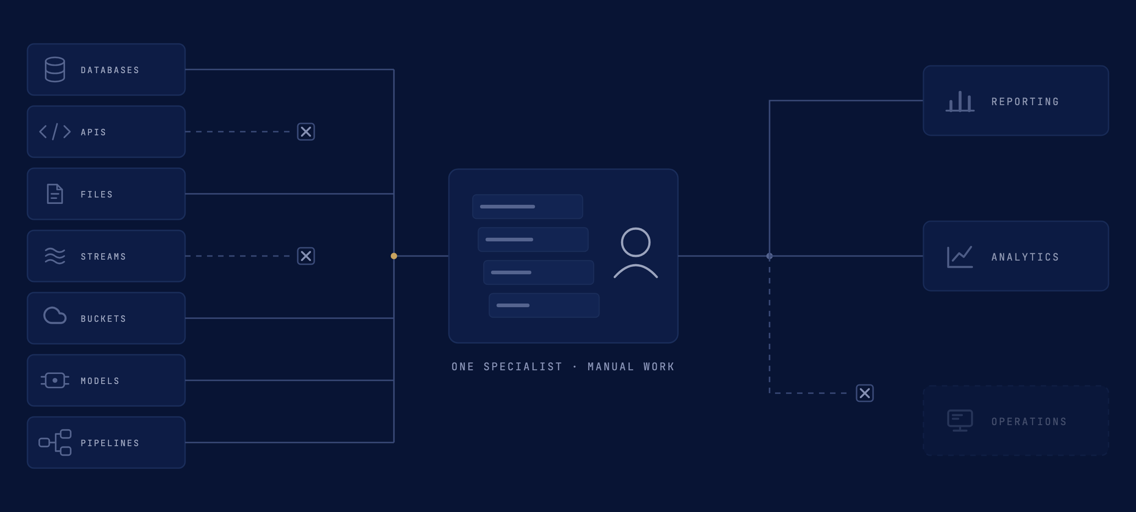
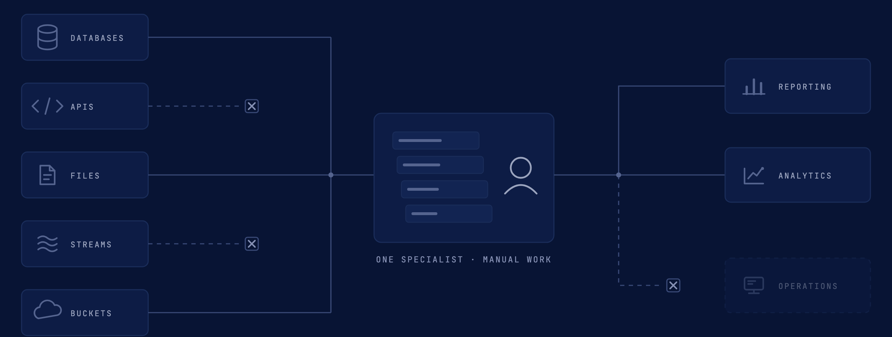
THE AGE-OLD PROBLEM
Every Feed Ends in a Person's Queue
Databases, APIs, files, streams, buckets, models, pipelines. Each one waits on a data engineering specialist.
CLEARFRACTURE.AI
02/13
Notes:
2

Slide 5
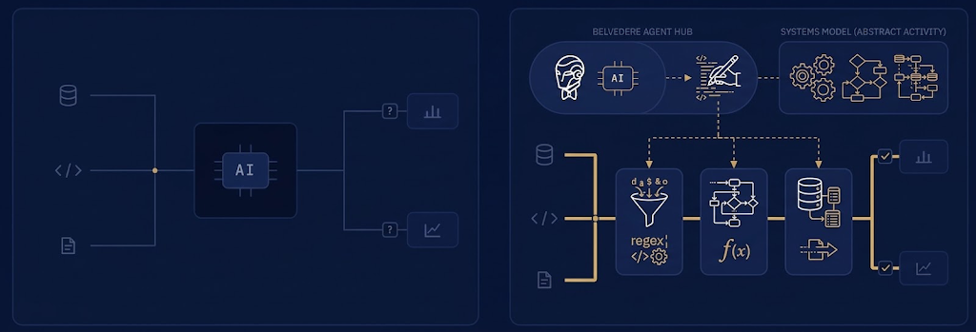
RESPONSIBLE AI
Agents should Build the Pipeline, Not Be the Pipeline
AI is best at design time. Data is handled by scalable, traceable code that never improvises. Knowledge is abstracted and retained.
AI IN THE DATA PATH:
RISKS: OPAQUE, VARIABLE, EXPENSIVE, HALLUCINATING
AI AT DESIGN TIME:
DETERMINISTIC CODE IN PRODUCTION, FORMAL KNOWLEDGE COMPOUNDS
CLEARFRACTURE.AI
05/13
Notes:
10

Slide 6
TRUE AGILITY
On-demand Fusion
When data prep is accelerated and abstracted mission needs can be supported at the moment of need
01
Timely responsiveness when mission situation surfaces new questions
02
Personalize processing for the desired analytical tool or individual cognition
03
Make the most of your existing, trusted, scalable data processing investments
04
Compounding knowledge improves future operations and reduces user burden
05
Better explainability, lineage, and authoritative data
Agentic acceleration with Belvedere:
Months become minutes!
CLEARFRACTURE.AI
Notes:
17

Slide 7
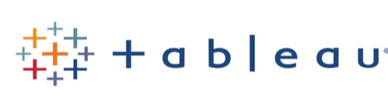
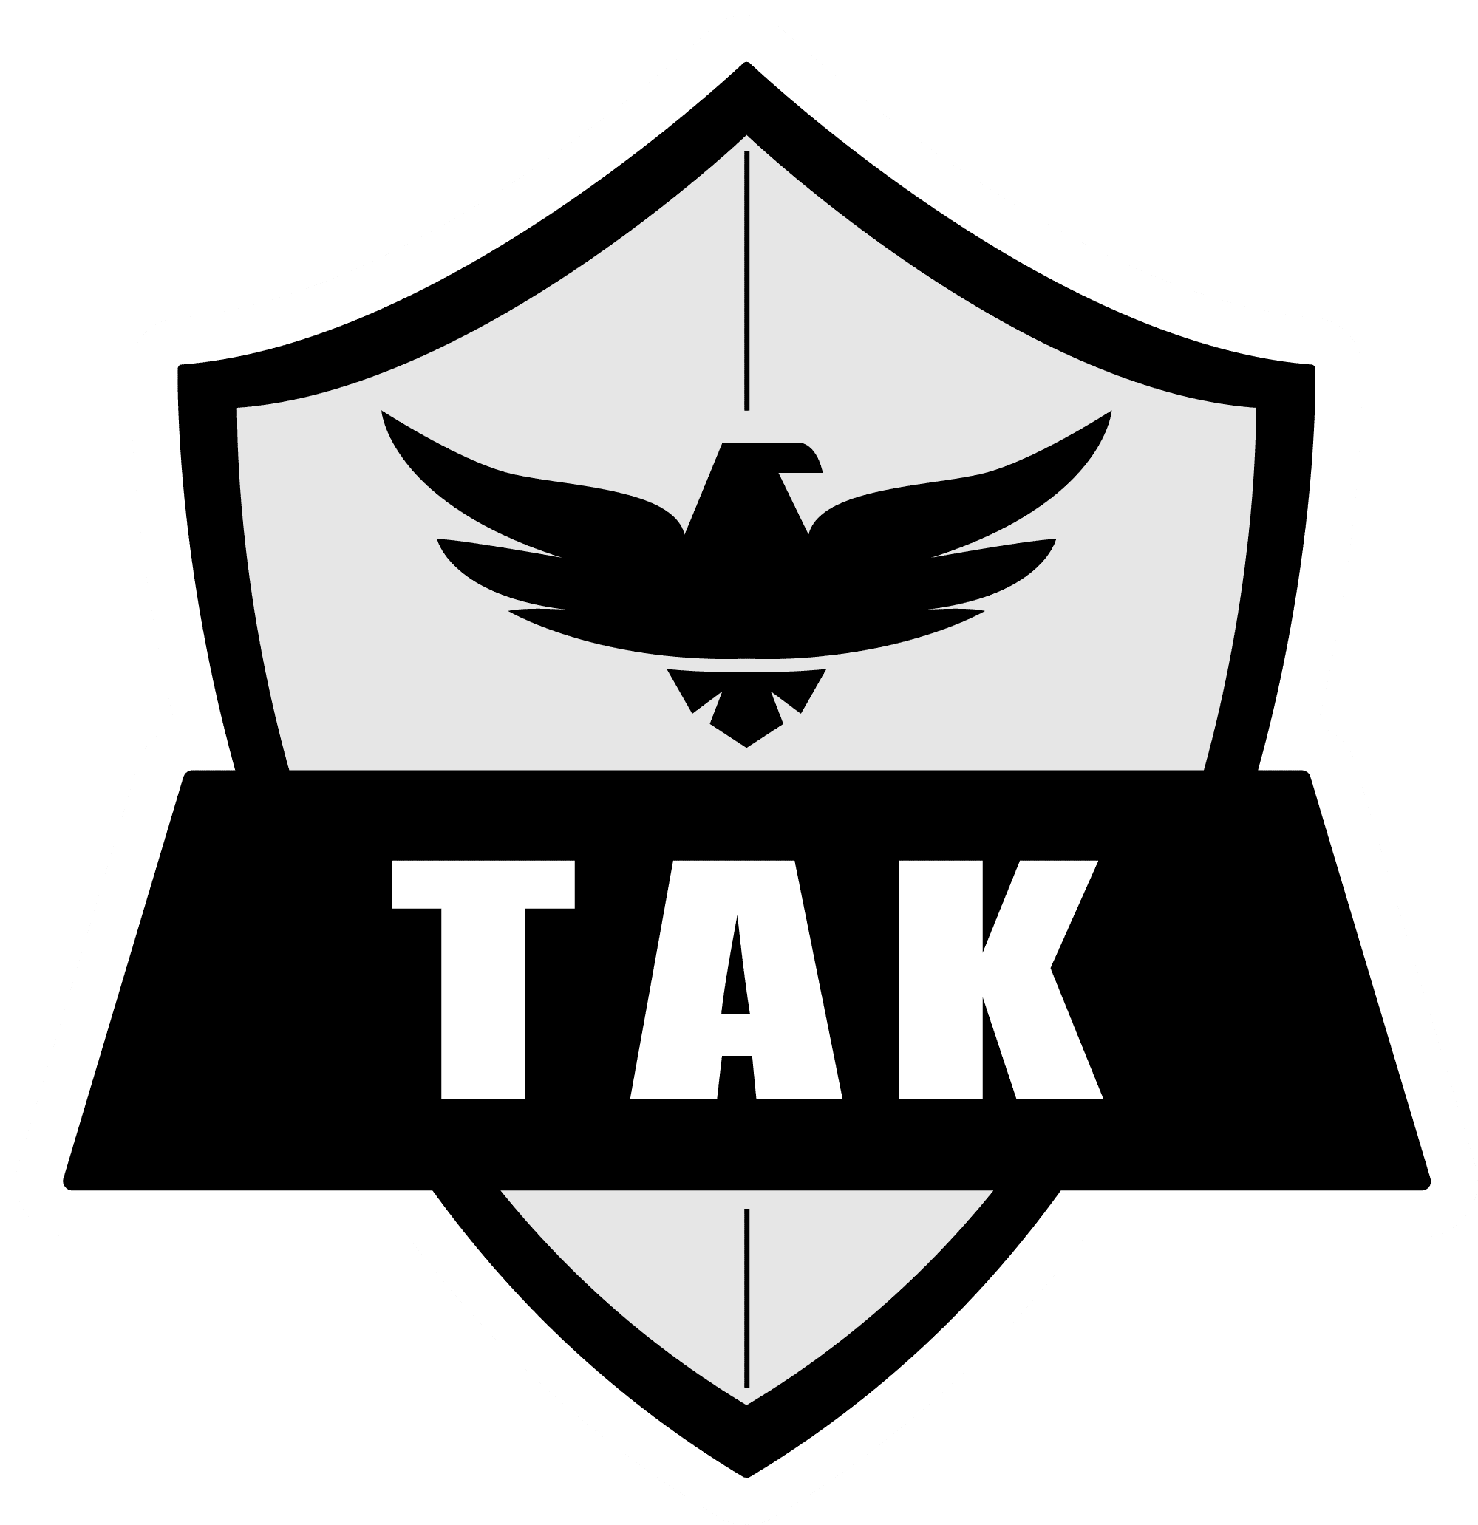



TRUE AGILITY
On-demand Fusion / Hackathon OSINT Fusion App
If data prep can be accelerated and abstracted mission needs can be supported at the moment of need
01
Mission situation surfaces new questions
02
OSINT-Fusion app manages tasking agentic on-demand data cube creation
03
Belvedere provides agentic acceleration of discovery through dissemination of fused data
04
OSINT-Fusion app help connect fused data to appropriate analytical tools
05
Analysis answers questions or leads to new questions that iterate through the cycle
Agentic Acceleration:
Belvedere
CLEARFRACTURE.AI
17
Notes:
17

Slide 8
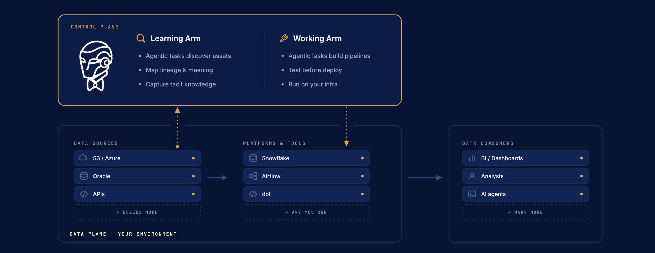
HOW BELVEDERE WORKS
The Two Arms of Belvedere
One arm learns your data estate. The other puts what it learned to work.
THE CONTROL PLANE ABOVE YOUR STACK · DATA NEVER FLOWS THROUGH BELVEDERE
CLEARFRACTURE.AI
Notes:
10

Slide 9
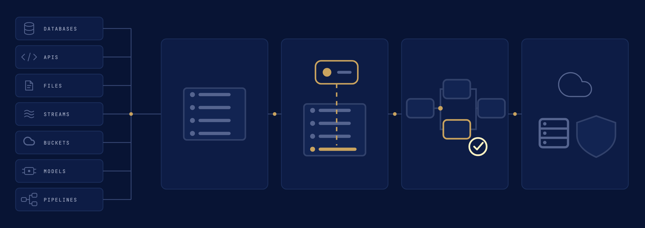
THE APPROACH
From Scattered Feeds to Deployed Data Products with Lineage
Agents do the labor. Your people stay in command.
CATALOG
ENRICH
OPERATIONALIZE
DEPLOY
Map every source/api/model
Agents add the meaning
Pipelines from the catalog
On your infrastructure
CLEARFRACTURE.AI
Notes:
4

Slide 10
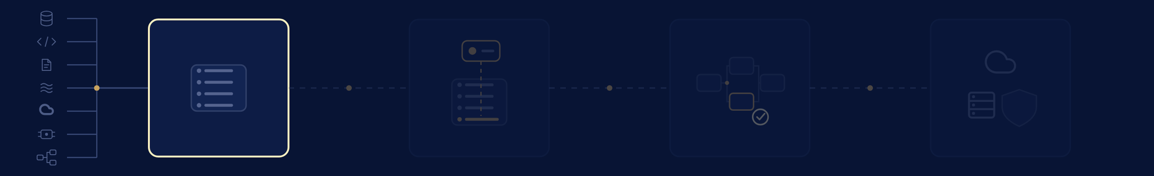
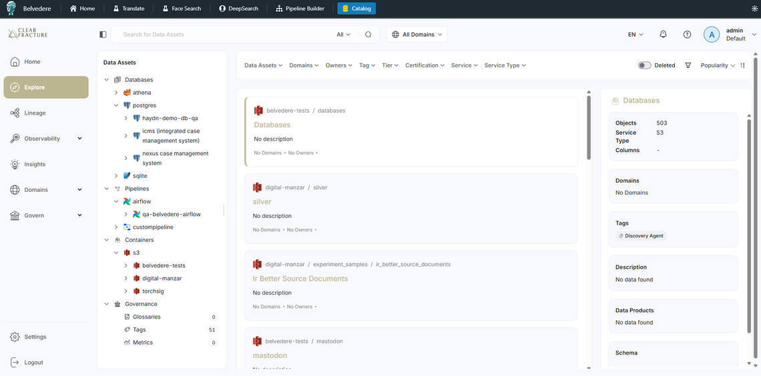
STEP 1 · CATALOG
Catalog Every Feed Source, Target, Endpoint
Connect your data enterprise to being building your data knowledge graph.
01
Connect
Connect Belvedere to your databases, buckets, streams, and APIs.
02
Discover
Agents survey each system and record schemas, samples, and stats.
03
One Source of Truth
Every feed lands in one living map: schemas, owners, relationships, lineage, changes.
Notes:
6

Slide 11
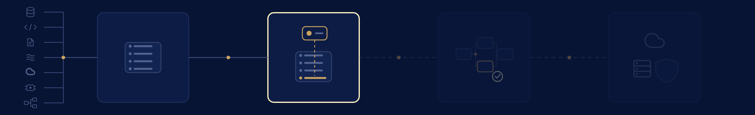
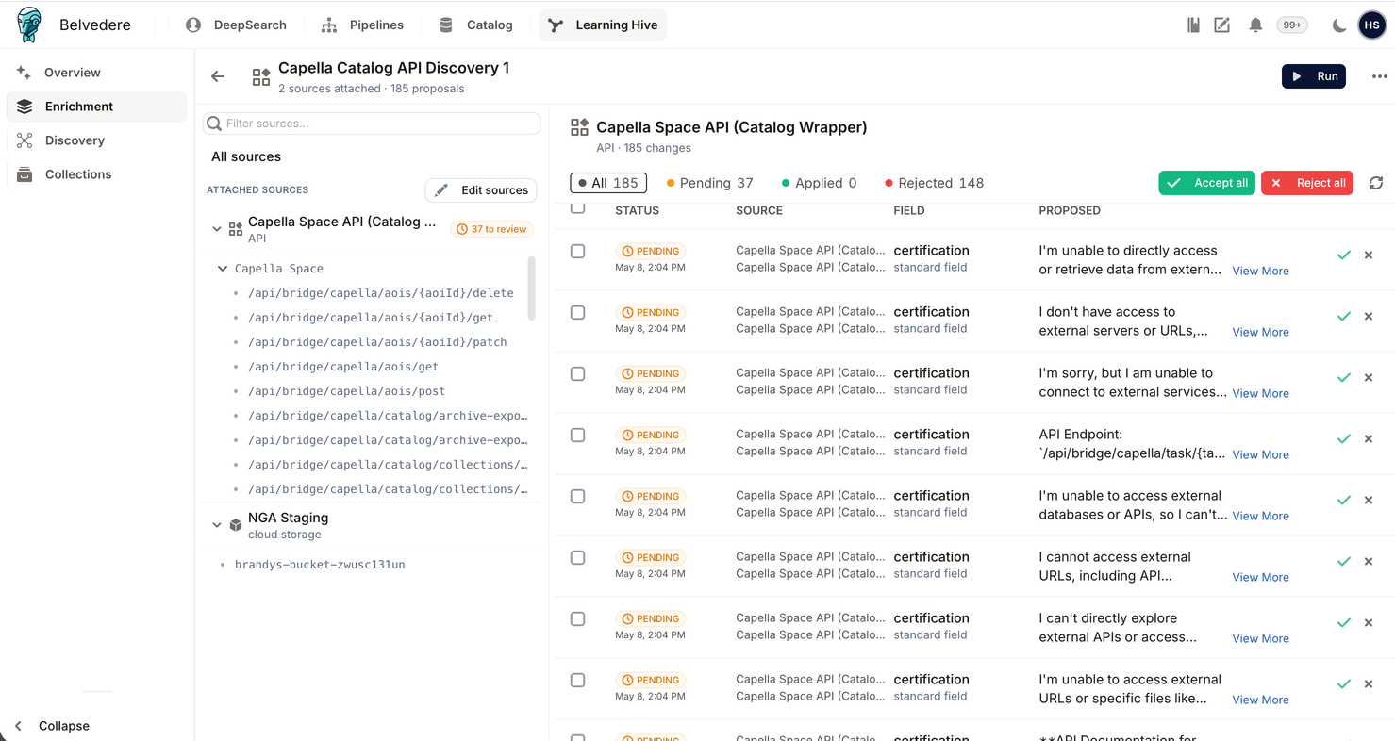
STEP 2 · ENRICH
Agents Enrich the Catalog
The catalog grows from an inventory into an understanding of your data.
01
Semantic Mapping
Columns link to shared concepts, so tables explain themselves.
02
Lineage
Every field traces back to its source and forward to everything it feeds.
03
Build Your Knowledge Graph
What lived in people's heads combined with agentic discovery become structure the agents can use.
Notes:
7

Slide 12
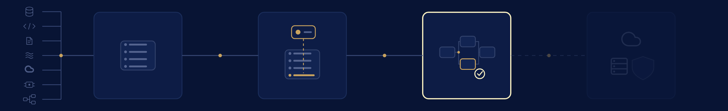
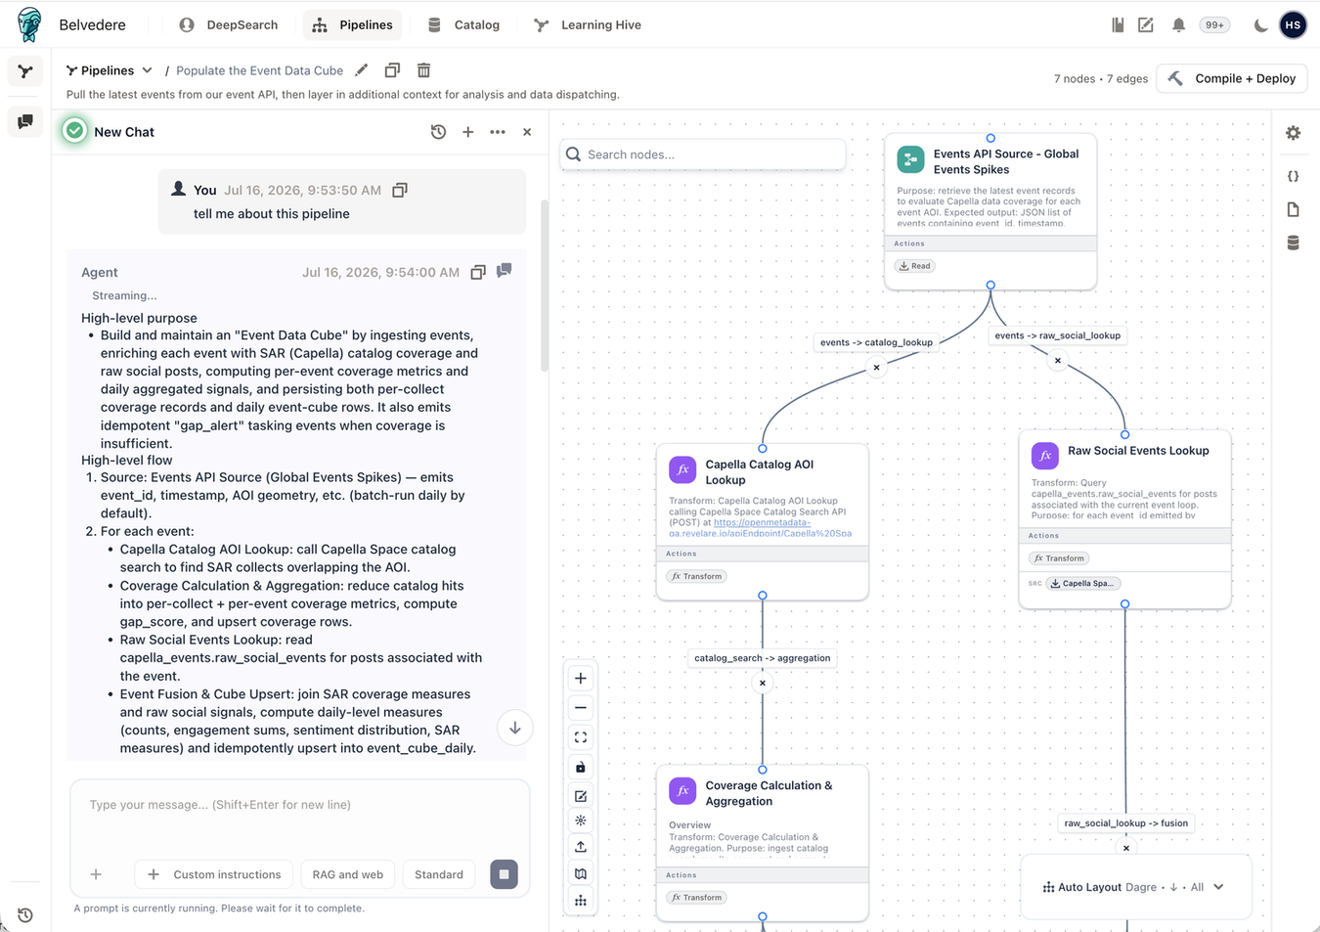
STEP 3 · OPERATIONALIZE
Make the Data Operational
Describe the data products you need. Belvedere engineers the pipelines behind them.
01
Declare
Describe the data product you need, in plain language.
02
Design & approve
Agents draw the workflow from the catalog. A person approves every change.
03
Compiled code
Tested pipeline code runs on your stack. No per-row AI calls.
Notes:
8

Slide 13


STEP 4 · DEPLOY
Deploy Across Your Infrastructure
Belvedere compiles pipelines to the platforms you already run.
01
Your platforms
Compiles to the stack you already run (e.g. Airflow, Dagster, AWS Glue).
02
Any enclave
Cloud, on-premises, or fully air-gapped.
03
Ordinary compute
CLOUD
ON-PREMISES
AIR-GAPPED
Compiled code, not per-token inference. A fraction of the cost.
CLEARFRACTURE.AI
Notes:
12

Slide 14
OUR METHODOLOGY
The Speed of AI, with Engineering Discipline
What the agentic approach delivers, and the rules it never breaks.
01
From intent to deployable code
Plain language in. Visual workflows and tested pipeline code out, with a full audit trail.
02
Deterministic in production
Agents design; approved, tested code executes. Production never improvises.
03
A fraction of the cost
No per-token inference on every row. Ordinary code on ordinary compute.
04
People stay in command
Agents propose. Your team approves every change.
05
Built for hard environments
Cloud, on-prem, or fully air-gapped. Your data never leaves your enclave.
CLEARFRACTURE.AI
Notes:
11

Slide 15
NOW WHAT
Where Teams Start
Common starting places for Belvedere.
01
Migration & sync
Semantically map schemas, build the pipelines, prove parity.
02
“Junk drawer” clean-up
Scattered raw files are organized and become data you can query.
03
Test & evaluation
Easily arrange components to be tested in any desired configuration. Standardize telemetry for every run, so teams compare apples to apples.
04
Entity resolution
Scattered records become one full picture of a person, asset, or account.
05
Sensor fusion
Define new data cubes as mission asks different questions or new feed become available. No need to deploy developers to the edge.
CLEARFRACTURE.AI
Notes:
13

Slide 16

Belvedere Brings AI-Native Data Operations to Complex Organizations
GET A DEMO
clearfracture.ai/demo
Notes:
19

